Slide 1
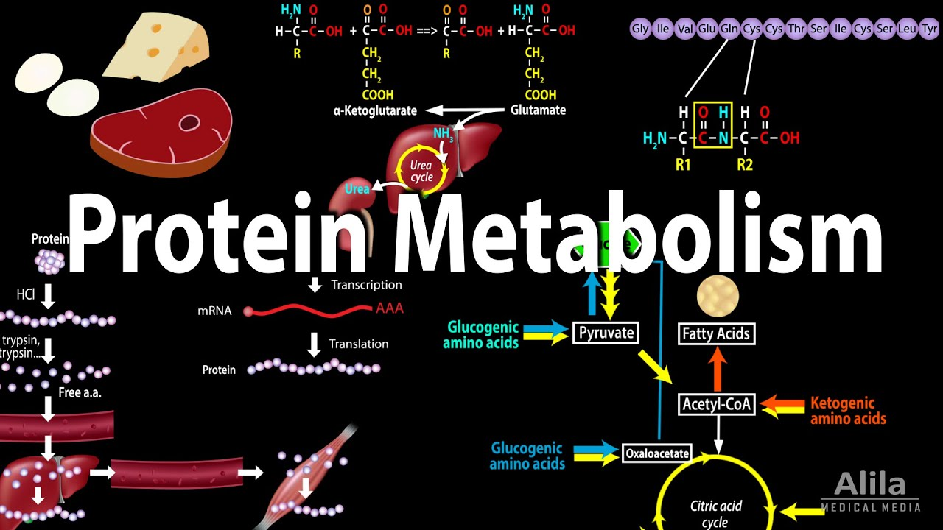
By: Dr. Kalpana Jorasia
Assistant Professor
(VPB)

Slide 2
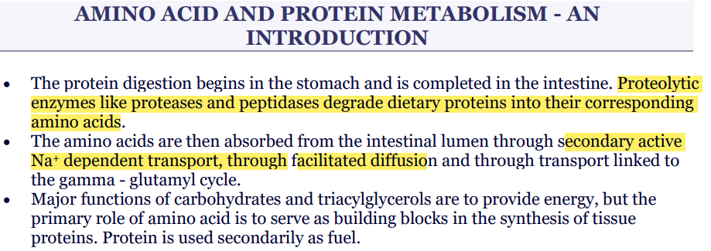

Slide 3
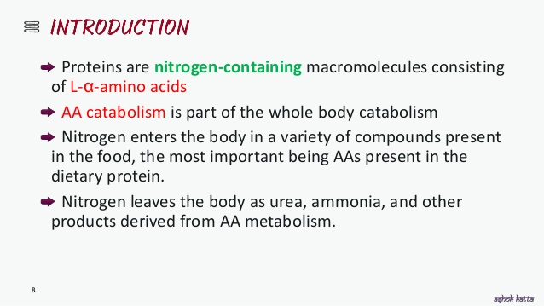
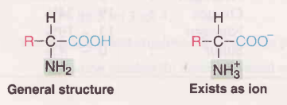

Slide 4
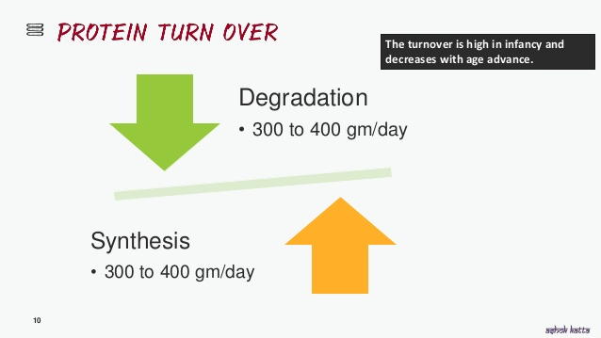

Slide 5
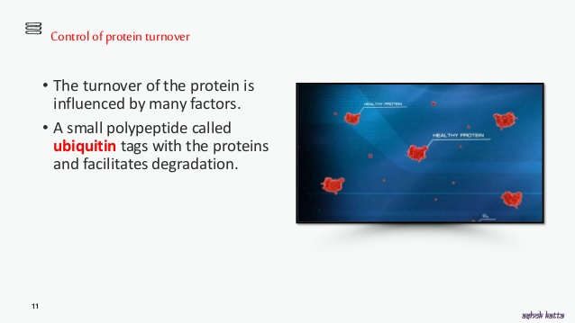
There is no storage form of amino acids as is the case for carbohydrates (glycogen) and lipids (triacylglycerols). The excess intake of amino acids are metabolized-oxidized to provide energy/ converted to glucose or fat

Slide 6
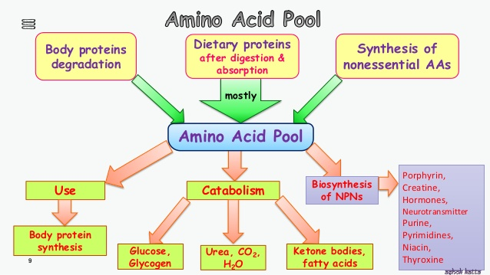

Slide 7
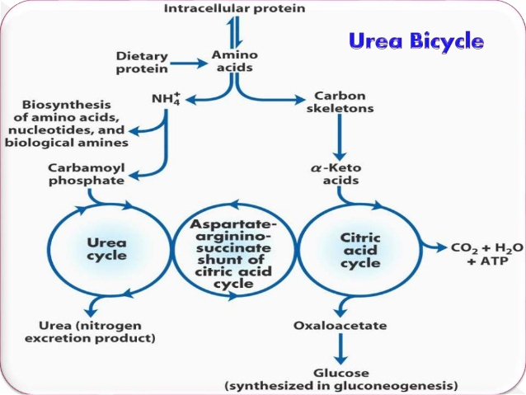
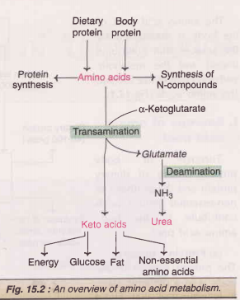
Overview of amino acid catabolism in mammals

Slide 8
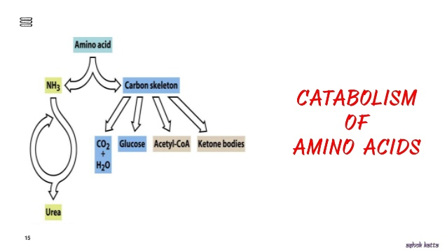

Slide 9
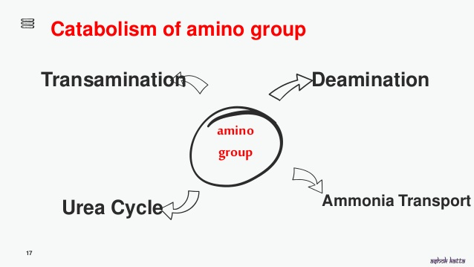
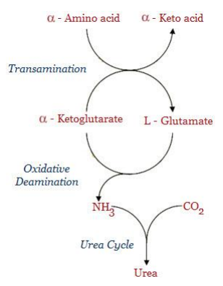

Slide 10
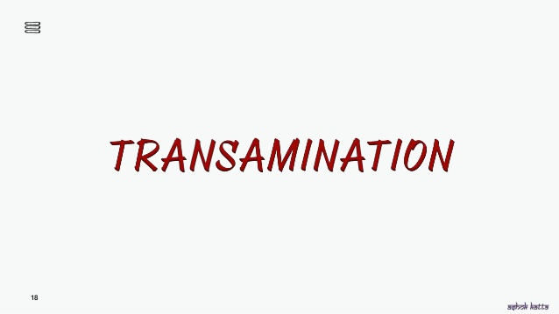
Amphibolic in nature

Slide 11
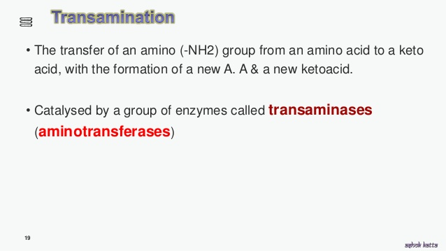
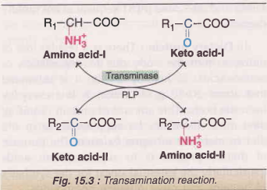
Alanine transferase(ALT)
Aspartate transaminase(AST)

Slide 12
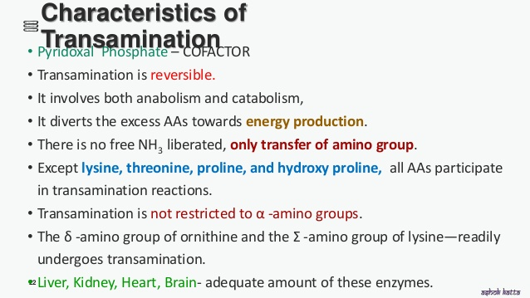
PLP(pyridoxal phosphate)- vitamine B₆
Serum transaminases are important for diagnostic and prognostic purpose

Slide 13
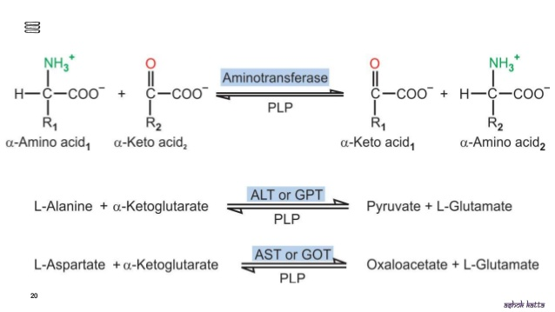
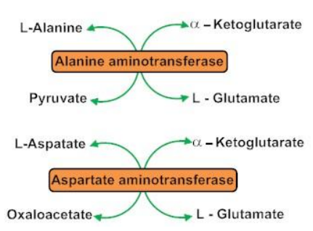

Slide 14
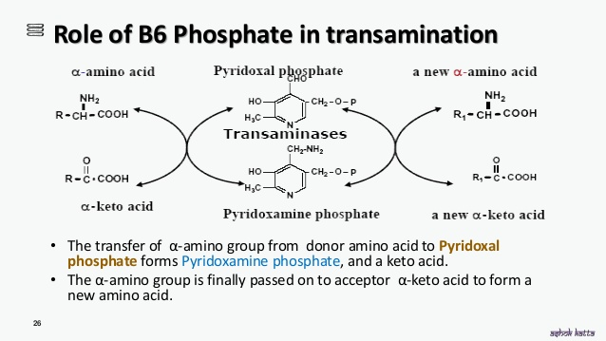

Slide 15
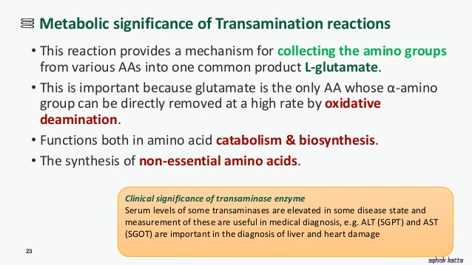

Slide 16
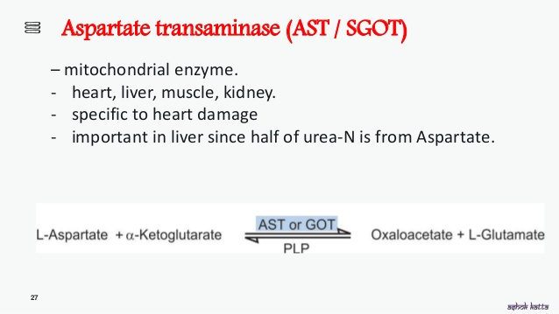

Slide 17
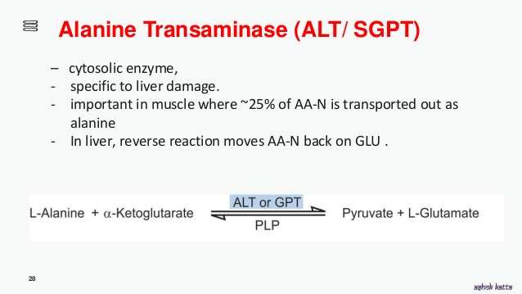

Slide 18

Mitochondrial Matrix

Slide 19
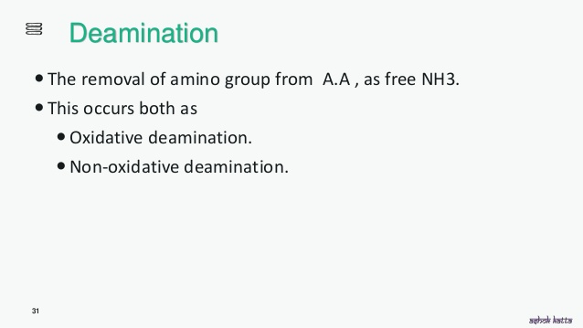
Deamination results in the liberation of ammonia for urea synthesis
Some authors use the term transdeamination while describing the reactions of transamination and deamination,particularly involving glutamate
Glutamate is the only amino acid that undergoes oxidative deamination to a significant extent to liberate free NH3 for urea synthesis

Slide 20
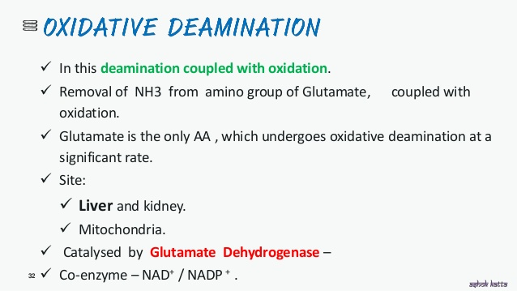

Slide 21
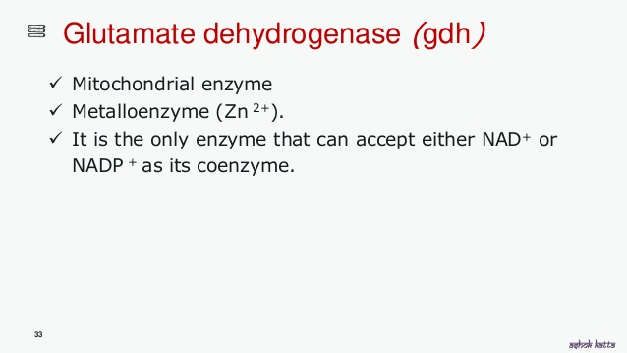
Glutamate serves as a 'collection centre' for amino groups in the biological system.

Slide 22
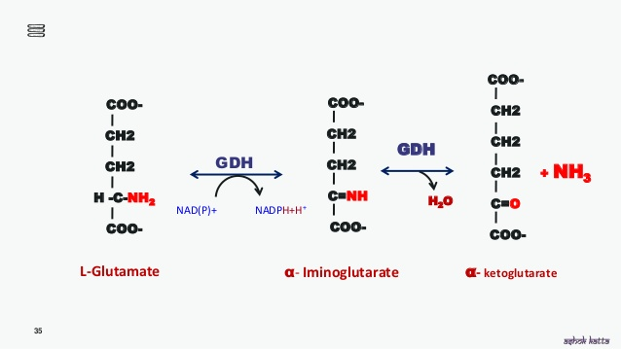

Slide 23
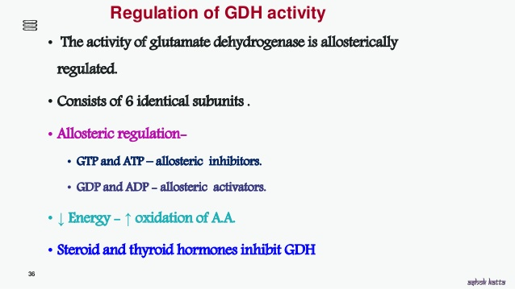

Slide 24
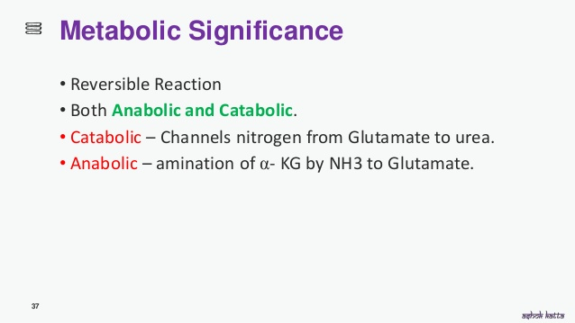

Slide 25
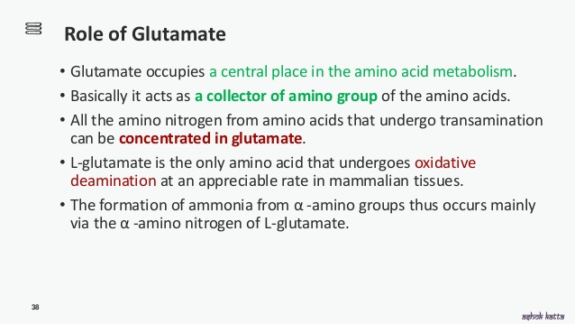

Slide 26
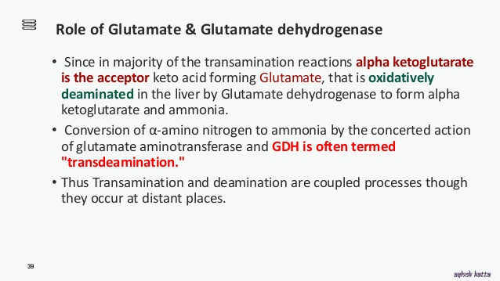

Slide 27
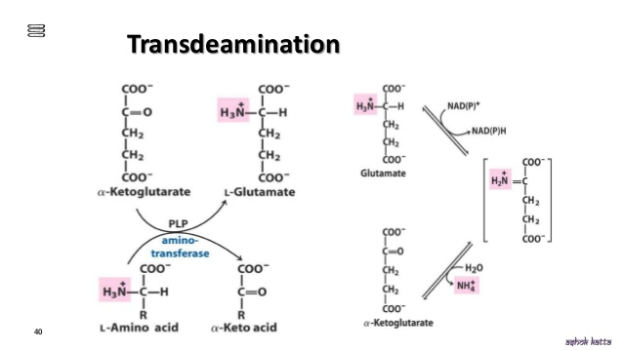

Slide 28
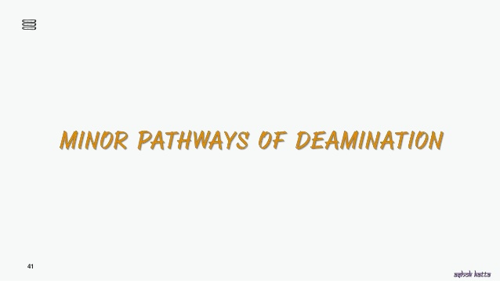

Slide 29
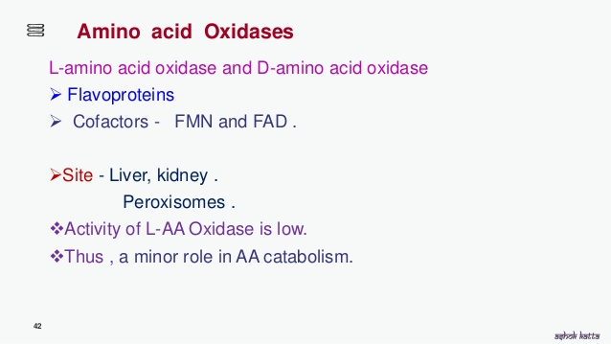

Slide 30
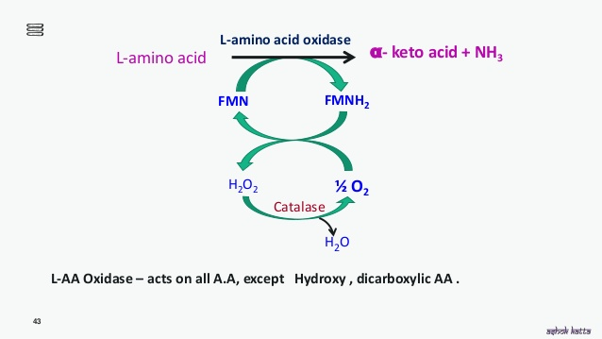

Slide 31
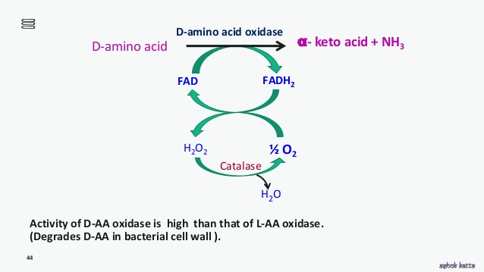

Slide 32
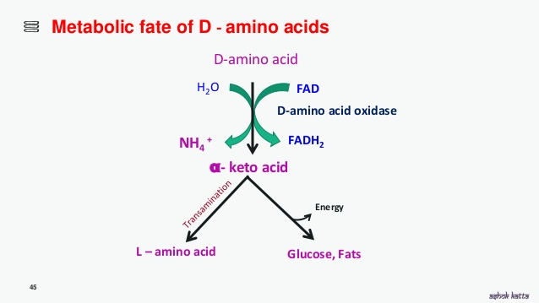

Slide 33
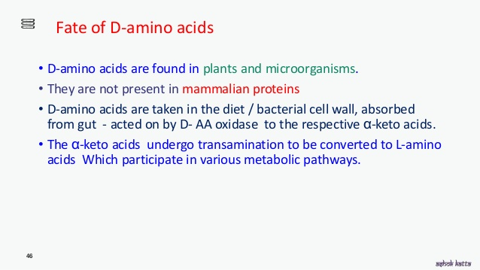

Slide 34
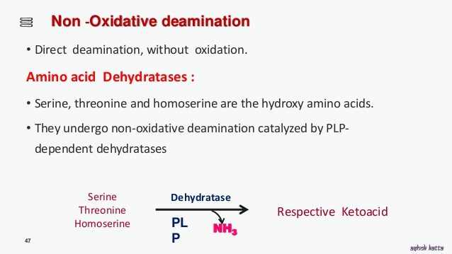

Slide 35
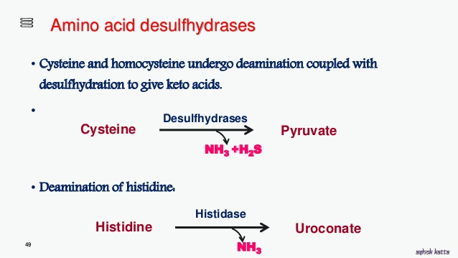

Slide 36
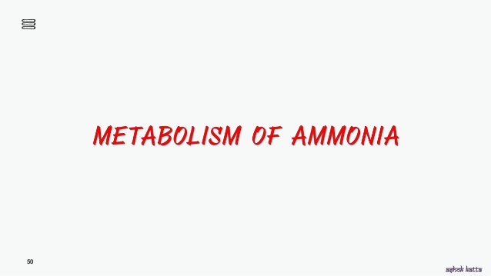

Slide 37
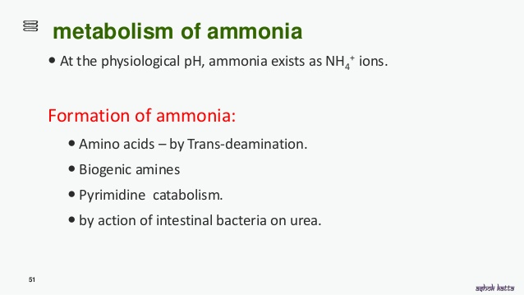

Slide 38
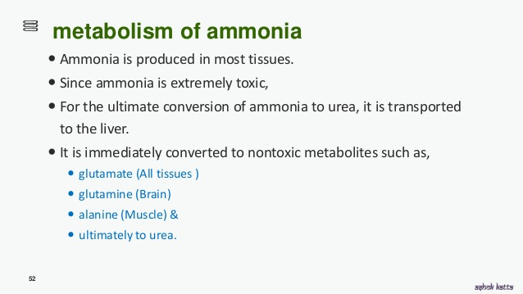

Slide 39
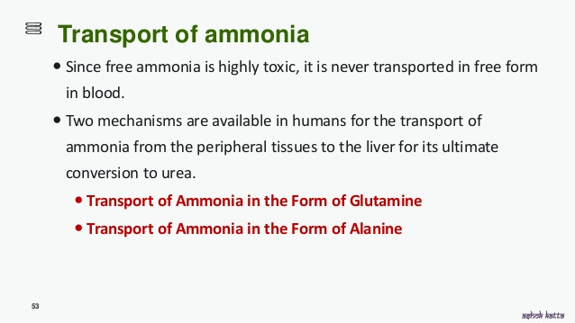

Slide 40
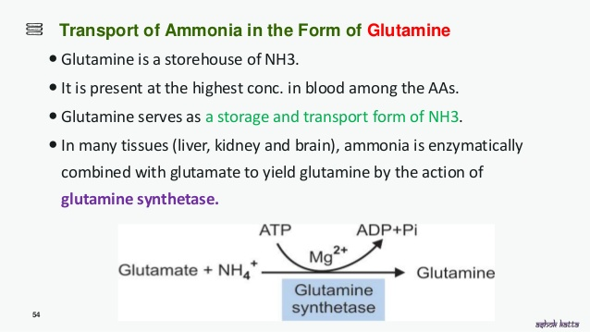

Slide 41
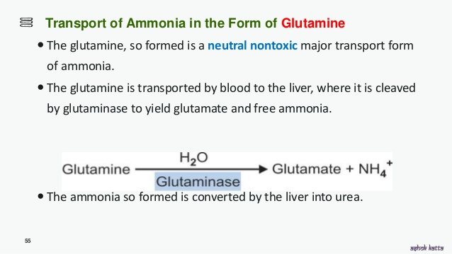
Glutamine is a store house of NH₃(ammonia).

Slide 42
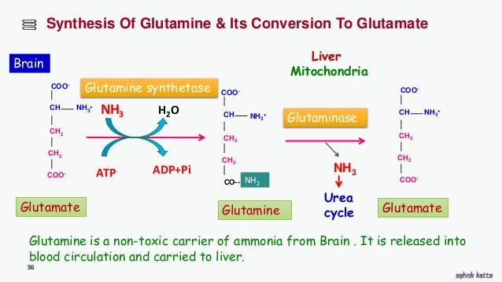

Slide 43
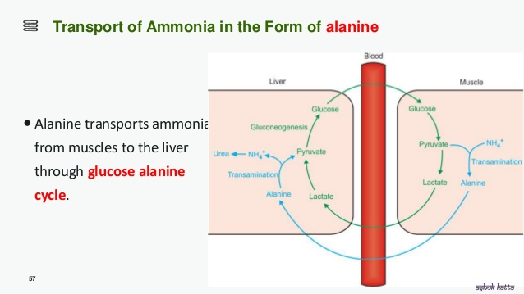

Slide 44
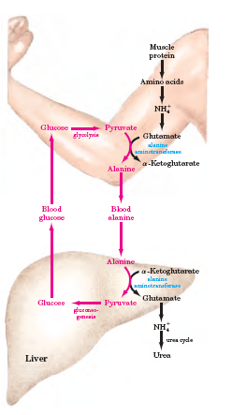
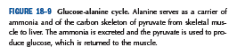
Glucose-alanine cycle

Slide 45
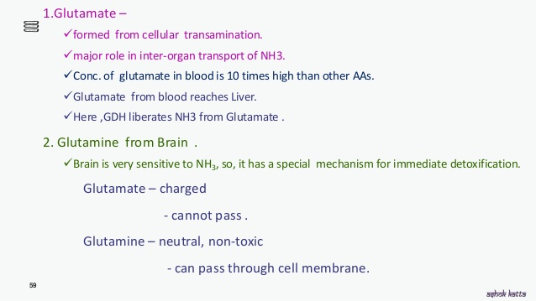

Slide 46

Disposal of ammonia

Slide 47


Slide 48

Ammonium ions= NH4⁺

Slide 49


Slide 50
Urea Cycle
Urea is the end product of protein metabolism (amino acid metabolism).
Urea is synthesized in liver and transported to kidneys for excretion in urine.
Urea cycle is the first metabolic cycle that was elucidated by Hans Krebs and Kurt Henseleit (1932), hence it is known as Krebs-Henseleit cycle.
Urea has two amino (-NH) groups, one derived from NH₃ and the other from aspartate.
Carbon atom is supplied by CO_{2.}
The first two enzymes are present in mitochondria while the rest are localized in cytosol.
Urea accounts for 80-90% of the nitrogen containing substances excreted in urine.

Slide 51


Slide 52
1. Synthesis of carbamoyl phosphate :
Carbamoyl phosphate synthase | (CPS l) of mitochondria catalyses the condensation of NH₄+ ions with CO₂ to form carbamoyl phosphate. This step consumes two ATP and is irreversible, and rate-limiting.
CPS I requires N-acetylglutamate (NAG) for its activity.
2. Arginase is mostly found in the liver, while the rest of the enzymes (four)of urea cycle are also present in other tissues.
For this reason, arginine synthesis may occur to varying degrees in many tissues. But only the liver can ultimately produce urea.

Slide 53


Slide 54

Urea Cycle

Slide 55


Slide 56

Urea cycle

Slide 57

Regulation of urea cycle
The first reaction catalysed by carbamoyl phosphate synthase I (CPS l) is rate Jimiting reaction or committed step in urea synthesis.
CPS I is allosterically activated by N-acetylglutamate (NAG).
lt is synthesized from glutamate and acetyl CoA by synthase and degraded by a hydrolase.

Slide 58
Bioenergetics of urea cycle
The urea cycle is irreversible
consumes 4 ATP.
Two ATP are utilized for the synthesis of carbamoyl phosphate.
One ATP is converted to AMP and PPi to produce arginosuccinate which equals to 2 ATP.
Hence 4 ATP are actually consumed.

Slide 59


Slide 60

Integration by urea cycle and TCA cycle
ATP (12) are generated in the TCA cycle
while ATP (4) are utilized for urea synthesis

Slide 61
The term 'uremia' is used to indicate increased blood urea levels due to renal failure.
Azotemia reflects a condition with elevation in blood urea,/or other nitrogen metabolites which may or may not be associated with renal diseases.
Non protein nitrogen (NPN)
NPN refers to all the nitrogen-containing substances other than proteins. These include urea (most abundant), creatinine, creatine, uric acid, peptides, amino acids etc.
The molecular weight of urea is 60 and about half of it (28) is contributed by the two nitrogen atoms. Thus, if blood urea concentration is 60 mg, then about half of it-28 mg-is blood urea nitrogen (BU N). Therefore,
BUN = 1/2 NPN
NPN = 2 BUN

Slide 62

Summary of amino acid metabolism

Slide 63


Slide 64


Slide 65


Slide 66


